Slide 1

https://www.uni-goettingen.de/en/48115.html
Unless I explicitly state otherwise, images and cartoons are created using ChatGPT.
You may use this material free of charge under the terms of the CC BY license. This requires that you provide appropriate attribution to the author: W. Link, University of Goettingen, Germany.
In a few cases, individual images, photographs, or similar material may be subject to a more restrictive Creative Commons license. Where this applies, it is explicitly indicated, and you must comply with the stated license terms for those items.
Please check the license information carefully before reuse. Responsibility for complying with the applicable license terms rests entirely with you.
PopGen_Ch-9
Population Genetics; LD Linkage Disequilibrium I
1

Slide 2
Sequential Number: #10
UNPLAB-PopGen_Ch-9[LD I]
In case you have arrived here without any prior information: This is a chapter from a series of chapters, intended as learning modules for the agricultural subject of Plant Breeding, at the level of a scientific Master's degree. There are no credits and no guarantees, and you - yourself - are responsible for what you take away, what you learn, and how you deal with content, form, shape and mood ;-)
© Wolfgang Link, Göttingen, Germany, 2025
2

Slide 3
You already know:
Hardy-Weinberg Equilibrium. Inbreeding Coefficient. Natural Selection, Fitness, Coefficient of Selection (aka Selection Coefficient). Balance between Selection and Mutation, joint effect of Selection and Drift.
Keywords of this chapter (PopGen_Ch-9):
Gamete Phase Equilibrium, Linkage Equilibrium (and Disequilibrium as well).
LD (Linkage Disequilibrium). Decay of LD.
Gamete Phases. Coupling Phase. Repulsion Phase. Parental and Recombined phase.
Algebra:
r = frequency of haplotype AB
s = frequency of haplotype Ab
t = frequency of haplotype aB
u = frequency of haplotype ab
Gamete Phase Equilibrium of two loci is realized if their LD=0 this means if D=0: D=ru-st
3

Slide 4
We have, in the last chapters, dived into Population Genetics; with a focus on Hardy-Weinberg Equilibrium as Reference and Frame and Anchor setting; and on the Forces that may push a population away from that specific (theoretical) status.
Forces:
Non-random mating (we focussed on self-fertilization)
Drift (gametes that ‚make‘ the next generation are too few in numbers to be really a representative sample of the parental generation)
Selection, Mutation (you know …)
Migration (well, was just mentioned).
In this chapter now, we will focus on an ‘Equilibrium’ which is not the HWE but – especially in modern times with DNA markers and genome sequences – even more important than some decades ago.
4

Slide 5
Are you rather the impatient type, or are you the cooperative, the work-obsessed, the achievement-orientated, the aggressive, the stressed or the pleasant-natured Type?
Okay, … this is not our question. Here, we look on this ‚Type‘: the so-called haplotype. What is a haplotype?
5

Slide 6
6
Type ... what is is haplotype
Okay, … this is not our question. Here, we look on this ‚Type‘: the so-called haplotype. What is a haplotype?
●Als Haplotyp (Abkürzung von „haploider Genotyp“) wird eine Variante einer Nukleotidsequenz auf ein und demselben Chromosom im Genom eines Lebewesens bezeichnet. Ein bestimmter Haplotyp kann individuen-, populations- oder auch artspezifisch sein. ’On same chromosome‘ ... thus .. ►linkage. Wikipedia, German.
● A haplotype (haploid genotype) is a group of alleles in an organism that are inherited together from a single parent.
Inherited together ... no explicit statement on linkage. From same parent ... phased ... Wikipedia, English.
● … die dabei verglichenen Allele können ... individuelle Kombinationen von SNPs sein, die als genetische Marker
benutzt werden können. www.biologie-seite.de. Haplotypes may serve as DNA-markers, similar to SNPs.
● A haplotype is a group of genes within an organism that was inherited together from a single parent. ...
A haplotype can describe a pair of genes inherited together from one parent on one chromosome, or it can
describe all of the genes on a chromosome …. ww.nature.com/scitable/definition/haplotype-haplotypes-142.
So what? What-the-heck is a haplotype?
If we have A, a, α and we have B, b as alleles in two loci, then these are the thus-possible haplotypes:
AB Ab aB ab αB αb.
Here, with three and two alleles, we have six variants for ‚haplotype‘. Nota bene, 6 is more than 3 or 2!
We can of course grasp a haplotype with (many) more than 2 loci, … depends on circumstances and purposes. …
A
B
C
D

Slide 7
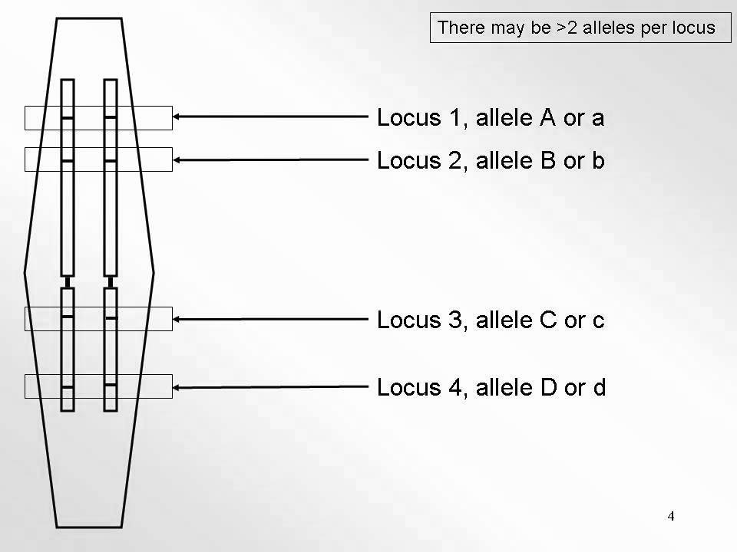
When talking about HWE, thus about frequencies of homozygotes (and heterozygotes), we talk about within-genotype-co-occurence of one copy of allele A with another copy of allele A (or of allele a; same! locus).
There may of course be > 2 alleles per locus
For the new type of equilibrium towards which we are now heading, ...
for this, we talk about co-occurence of one copy of allele A with a copy of allele B (two different! loci involved); within gametes (well; gametes make zygotes thus genotypes, so eventually this co-occurrence then is transferred into genotypes).
Instead of asking
whether ‚A‘ comes (homozygous) with ‚A‘ or (heterozygous) with ‚a‘, we now ask whether ‚A‘ at its locus comes (…) with ‚B‘ or (…) with ‚b‘ at that-one’s locus.
Sketch of a diploid plant
cell with a one-chromo-some genome ;-)
7

Slide 8
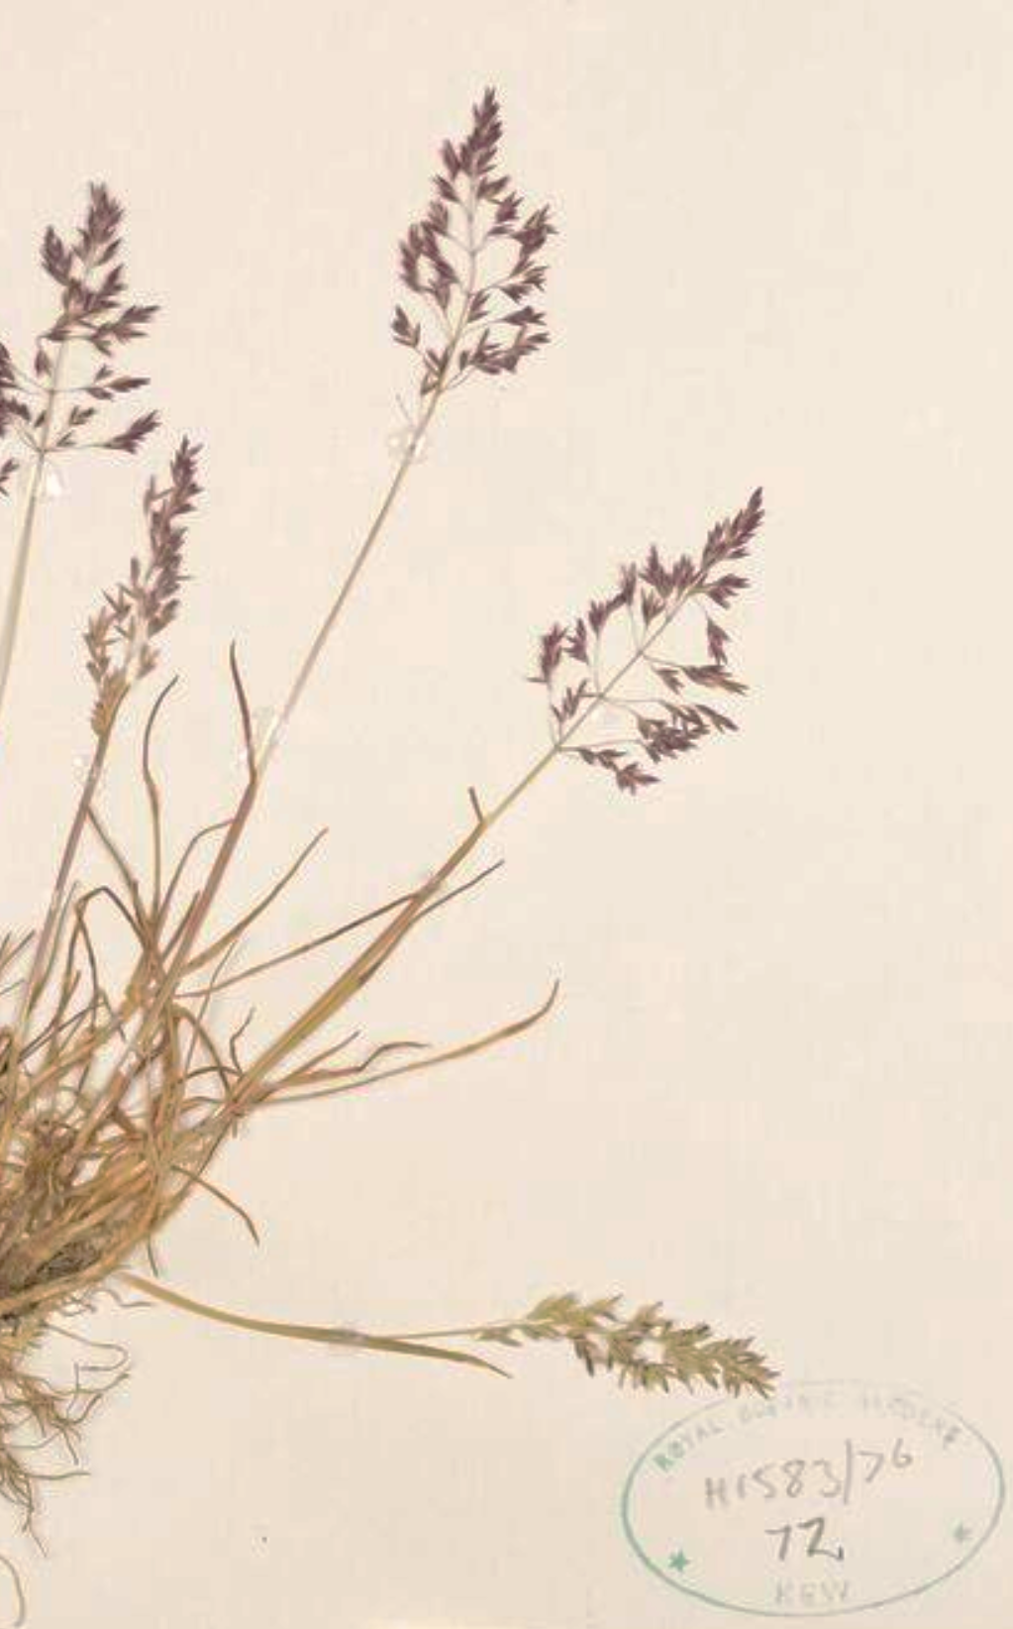
Just for fun ... Do organisms exist with only one chromosome per
genome: haploid 1n=1x=1 and diploid 2n=2x=2
The lowest possible chromosome number (2n = 2) was
found in some groups of the Australian ant 🐜 Myrmecia pilosa.
Such low chromosome number was not found in plants, yet,
plant species exist with 2n=2x=4, such as
Colpodium versicolor which is a grass species.
10.1080/11263504.2012.714806
High chromosome numbers are such as 2n=80 (sugar cane, Saccharum officinale). Imagine the busy meiotic apparatus with so many chromosomes, and the oftentimes aneuploid gametes resulting from this …
Fl. Sredn. Južn.
Rossii 2: 638 (1897)
8

Slide 9
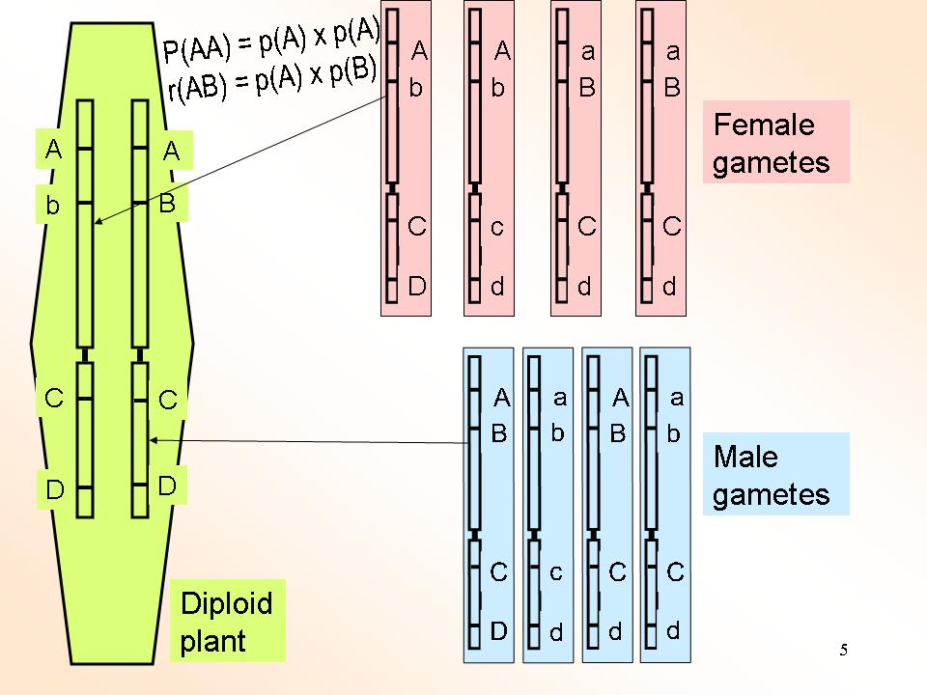
The here-advertised type of equilibrium comes as (1) Gamete phase equilibrium or as
(2) Linkage equilibrium; two names*.
Genes do not occur alone. In dip-loids, they are in couples: Two genes per locus. Either twice the same (such as ‚AA‘) or two different alleles per locus (such as ‚Aa‘). Now, we focus on a further ‚way‘ of grouping genes.
Let us focus on allele ‚A‘ at one locus and look for allele ‚B‘ at a different locus. These two (non-allelic) genes could be assembled into the same gamete (gamete AB) - or not-in-same gamete (Ab, aB, ab).
Bringing A and B together into the same gamete does, by the way, not yet tell whether they are located …
► at the same chromosome or
► at different chromosomes
(well, I assume that the species has more than one chromosome).
Some even say „linkage phase (dis)equilibrium, hence* three names (ISBN 978-3-8252-4950-2)
9

Slide 10
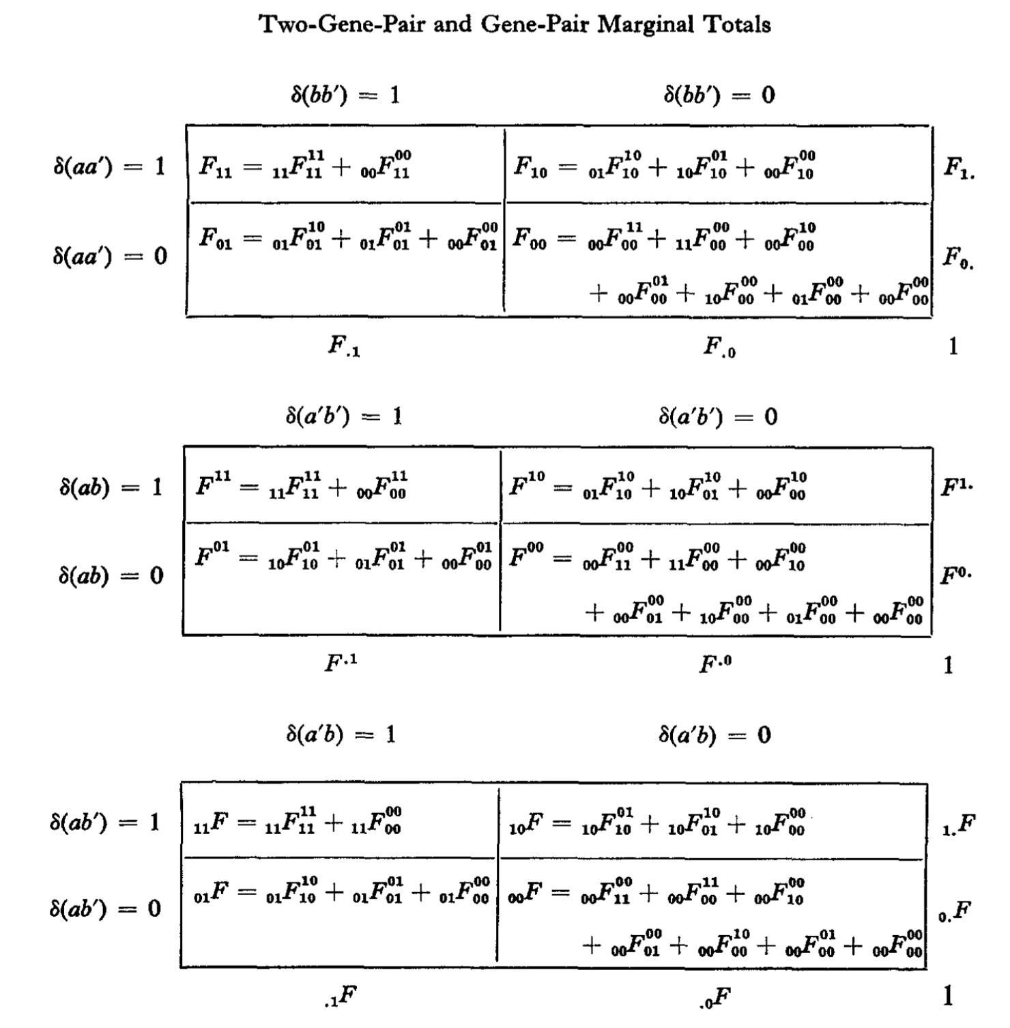
Just for completeness and honesty, I want to name this citation:
‚Descent measures for two loci with some applications‘.
Bruce S. Weir & C. Clarke Cockerham. 1973.
DOI 10.1016/0040-5809(73)90013-0
Read it if you share their passion
for this issue ;-)
This paper explains all descent measures
and equilibria for two loci and their alleles
(including HWE and Gamete Phase Equilibrium). .
10

Slide 11
The here-advertised type of equilibrium comes as (1) Gamete phase equilibrium or as
(2) Linkage phase equilibrium.
In Hardy-Weinberg Equilibrium, …
if we have p(A)=1/2 and q(a)=1/2, then we expect p²=P(AA) = 1/4
(random joining of alleles ‚A‘
and ‚a‘ into zygotes hence plants).
Consider two different loci.
Locus 1: p(A)=1/2; p(a)=1/2.
Locus 2: p(B)=1/6; q(b)=5/6.
What would you expect to be the frequency of gametes containing
„A and B“ ?
… or containing „A and b“?
11

Slide 12
Gamete phase equilibrium or, synonym, Linkage equilibrium.
Consider two loci.
Locus 1: p(A)=1/2; q(a)=1/2.
Locus 2: p(B)=1/6; q(b)=5/6.
What would you expect to be the frequency of gametes „A and B“ ?
If meiosis has been busy with shuffl-ing and recombining the genes back and forth and all else is ‚fine‘, then shouldn‘t the combination „A and B“ occur with
„1/2 ∙ 1/6“ … with
p(locus 1) ∙p(locus 2) = r = 1/12?
„A and b“ then with s = 5/12?
et cetera ?
If these are their frequencies, if these haplo-types occur like this, then the population is at
Gamete Phase Equilibrium  .
12

Slide 13
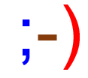
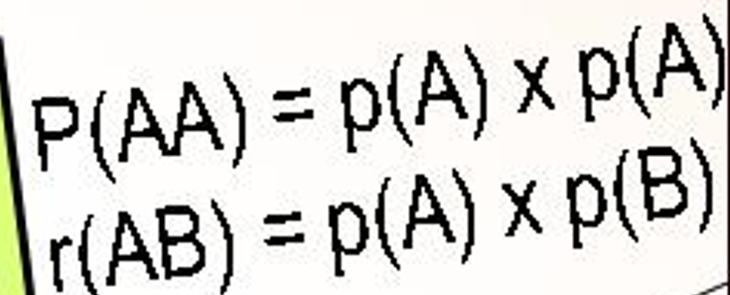
Gamete Phase Equilibrium = Linkage Equilibrium More Capital Letters, More Drama
Meanwhile you saw it ;-)
P(AA) symbolized the Hardy Weinberg Equilibrium. If HW-Equilibri-um is realized, then the frequency of the AA genotype, P(AA),
can be deduced from p(A) x p(A) = p²(A) ...
... whereas, if Gamete Phase Equilibrium is realized, then the frequency of the AB haplotype r(AB) can be deduced as r(AB) = p(A) ∙ p(B). Equilibrium then can be written as LD=0. ‘LD’ is oftentimes used to denote the quantity of any gamete phase DIS-equilibrium ≡ quantity of any Linkage phase DIS-equilibrium (synonyms, you know), and thus
LD= 0 says: „We have here zero DIS-equilibrium“. Means, of course, we have Equilibrium. Means, ‘A’ is not statistically associated with ‘B’ but occurs with B as expected when things are random.
13

Slide 14
How to quantify gamete phase disequilibria? What is a ‘phase’?
14
Focus (left diagram) on the female gametes alone, and on A-locus and B-locus. All alleles A occur with b (with means ‘in same haplotype’); all A are with b (well, both). For these two loci, we see a maximum of association, a maximum Gamete Phase Dis-equilibrium (different from C/c and D/d, where you do not see an association).
Focus on the male gametes. Again, maximum association: Yet, different version of association, since A with B, not with b ;-)
We name the phases „A-B“ plus „a-b“ as Coupling Phase.
We name the phases „A-b“ plus „a-B“ as Repulsion Phase.
If crossing AA/BB x aa/bb, repulsion phase in offspring occurs only via cross-over; in case of full linkage, repulsion phase would not occur. Do not mix up „coupling“ with “Kopplung“ with „linkage“.
In different traditions, instead of „coupling and repulsion“ you may find „parental gamete phase” and “recombined gamete phase“ (parental and recombined haplotype).
As, in modern genetics, we anyway oftentimes do not talk about LD of genes but about LD of DNA-markers, the concept of „A“ versus „a“ implying dominance of A over a is barely adequate. Hence, coupling denoting „dominant with dominant“ and „recessive with recessive“ may be less adequate than parental phase vs. recombined phase.

Slide 15
How to quantify the ‘amount of’ Gamete Phase Disequilibria?
Female gametes: Maximum LD. Negative D (repulsion phase prevails).
Male gametes: Maximum LD. Positive LD (coupling phase prevails).
Jointly (sum of all gametes), here LD is zero, because AB occurs as frequent (r=1/4) as expected from the frequencies of its constituting alleles A (p=0.5) and B (p=0.5); p² = r = 1/4.
We may say: Okay, taking a small sample of gametes (such as the four female gametes) may create LD although maybe LD=0 in the basic pool of gametes. ¡Indeed, Drift creates LD!
We may say: Joining two samples of gametes (females and males) with different LD may create a new, different LD situation.
Indeed: Mixture, Admixture, Migration create LD.
Nota bene: Selection and Mutation usually create LD, too. Of course ☺.
15

Slide 16
LD describes the gametes (haplotypes) and frequency of coupling & repulsion.
Gametes ‚make‘ zygotes (plants). In these plants, we may see the impact of posi-tive or negative, strong or small LD on performance and genetic variance.
Again: LD it is a feature of the gametic array and from them goes into the plants.
Gametes mate via self-fertilization or via random outcrossing. Selfing increases homozygosity and thus protects LD from further decay. Linkage protects LD from decay, too. If linkage is zero, then ongoing random outcrossing reduces LD by half per generation of random mating.
Cross two inbred lines. Choosing them created LD_{max} for all pairs of polymorphic loci: Irrelevant whether they are [AA/BB & aa/bb] or [AA/bb & aa/BB].
If these two loci are unlinked, the gametes coming from F1 Aa/Bb are with LD=0. LD_{max} to LD=0 in one step ☺. Such strong decay cannot be realized in a random mating population, because with p²≠0 & q²≠0, always some individuals are not double-heterozygous Aa/Bb but like Aa/bb, aa/BB etc., and therefore transfer their individual haplotype un-recombined into the next generation ;-)
16

Slide 17
LD describes the gametes (haplotypes) and frequency of coupling & repulsion.
Gametes ‚make‘ zygotes (plants). In these plants, we may see the impact of posi-tive or negative, strong or small LD on performance and genetic variance.
Again: LD it is a feature of the gametic array and from them goes into the plants.
Gametes mate via self-fertilization or via random outcrossing. Selfing increases homozygosity and thus protects LD from further decay. Linkage protects LD from decay, too. If linkage is zero, then ongoing random outcrossing reduces LD by half per generation of random mating.
Cross two inbred lines. Choosing them created LD_{max} for all pairs of polymorphic loci: Irrelevant whether they are such as [AA/BB & aa/bb] or like [AA/bb & aa/BB].
If these two loci are unlinked, the gametes coming from F1 Aa/Bb are with LD=0. LD_{max} to LD=0 in one step ☺. Such maximum decay cannot be realized in a random mating population, because with p²≠0 & q²≠0, always some individuals are not double-heterozygous Aa/Bb but like Aa/bb, aa/BB etc., and therefore transfer their individual haplotype un-recombined into the next generation ;-)
17

Slide 18
We see the following text again, because it is a nice example how you can get super deep insight for little mental investment :-)
Cross two inbred lines. Choosing them created LD_{max} for all pairs of polymorphic loci: Irrelevant whether they are such as [AA/BB & aa/bb] or like [AA/bb & aa/BB].
If these two loci are unlinked, the gametes coming from F1 Aa/Bb are with LD=0. LD_{max} to LD=0 in one step ☺. Such maximum decay cannot be realized in a random mating population, because with p²≠0 & q²≠0, always some individuals are not double-heterozygous Aa/Bb but like Aa/bb, aa/BB etc., and therefore transfer their individual haplotype un-recombined into the next generation ;-)
18

Slide 19
How to quantify Gamete Phase Disequilibria? Let us try here.
We take different allele frequencies in the 1. and 2. locus (p=0.5 vs p=1/6). The table shows perfect Gamete Phase Equilibrium, i.e. perfect Linkage (Phase) Equilibrium: LD=0.
To allow Algebra, haplotypes are coded. The alleles A and B bring code value 1, the alleles a and b bring code values 0.
The correlation coefficient between the codes at first locus and at second locus is r=0, which is self-evident: When seeing the value at the first locus, you cannot predict the value at the second locus. „A“-gametes bring „B“ and „b“ in the ratio 1 : 5 which is exactly the result of randomly taking gametes (exactly the overall-frequency of B and b: 1/6 vs 5/6).
One parameter to quantify LD is D, short for Disequilibrium. You see the Algebra ☺. D=0.
A
B
a
b
A
b
a
B
Again: ‚AB‘ etc. is not indica-ting heterozygosity at one diploid locus. No! No! No!
It is a haploid information. Here, it tells whether allele A (or a) at this locus is accom-pagnied with allele B (or b) at a different locus.
19

Slide 20
We are in the middle of everything, as LD is concerned.
To continue, you may go to the next chapter
PopGen_Ch-10
20
20

Slide 21
From here you may go to UNPLAB-PopGen_Ch-10[LD II]
21
21

